Slide 1
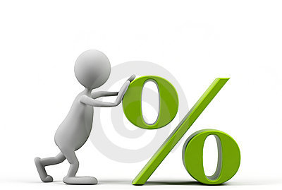


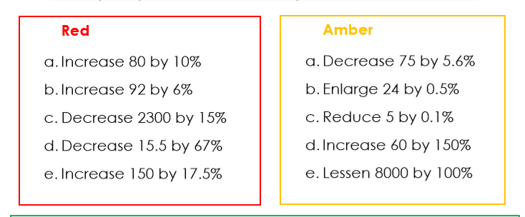
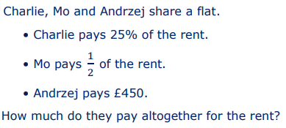
Keywords
Decrease
Percent (%)
Fractions
Hundred
Parts
EQ: How do I decrease Percentage
DATE
Percentage Decrease
STARTER
Depth

Slide 2
Contents
Glossary or Formula Page
Page
Date
Essential Question
24
7
30
Word or Formula
Definition or Example

Slide 3
Tasks
24
7
30
Topic
Essential Question
Questions
Notes
Summary
1
2

Slide 4
EQ: How do I decrease Percentage
Understanding
Let’s look at a percentage decrease using bars.
The original whole amount, 100% looks like this:
100%
70%
70% is 30% smaller as we have subtracted 30% from the 100% bar.
This would be called “a 30% decrease”
A 30% decrease makes the item 30% smaller

Slide 5

EQ: How do I decrease Percentage
Example
Harry, brought a new car for $17,500. As soon as Harry drove off in it the car’s value decreased by 7%. What is Harry’s car worth now?
STEP 1:
Without a calculator work out what 7% of $17,500 is
7% = 5% + 1% + 1%
7% = 875+ 175 + 175
7% = 1,225
STEP 2:
Depth:
Think about…
How would you calculate 93% using a calculator?
And why I put 93%
SUBTRACT this from Harry’s purchase price
$17,500 - $1,225 =
$16,275

Slide 6

EQ: How do I decrease Percentage
Hinge Question
Reduce the $125 suit by 20%
20% of $125 = $25
20% off
$125 - $25= $100
Notes:
If right go onto C&R.

Slide 7
L
LO: Percentage Decrease
Fluency and Understanding
In a sale, all normal prices are reduced by 12%
The normal price of a suit is $125.Work out the sale price of the suit
STEP 1:
Work out what 12% of $125 is
12% = 10% + 1% + 1%
12% = 12.50 + 1.25 + 1.25
12% = 15
QUESTION:
How would you calculate 12% using a calculator?
STEP 2:
Subtract this discount from the original price
$125 - $15 =
$110
Notes:
Go through in real time

Slide 8
EQ: How do I decrease Percentage
Hinge Questions
(a)
20 miles is decreased by 40%
(b)
80minutes is decreased by 35%
10% = 2miles
10% = 8mins
x4
x4
x3
30% =
x3
8miles
24mins
40% =
5% =
We now need to decrease 20miles by 8miles
4mins
28mins
35% =
12miles
We now need to decrease 80mins by 28mins
20miles - 8miles =
80mins - 28mins =
52mins
Notes:
If have higher and all correct ignore F&U and go onto C&R

Slide 9
EQ: How do I decrease Percentage
Fluency and Understanding
Work out the final amount when:
(a)
$ 68 is decreased by 10%
(b)
$ 90 is decreased by 30%
10% = $6.80
10% = $9
x3
$27
x3
$68 - $6.80 =
$61.20
30% =
$ 90 - $ 27 =
$63
(c)
(d)
$ 110 is decreased by 70%
$ 65 is decreased by 40%
10% = $ 6.50
10% = $ 11
x4
40% =
x4
x7
x7
$ 26
$ 77
70% =
$ 65 - $ 26 =
$39
$ 110 - $ 77 =
$33
(e)
$ 300 is decreased by 55%
10% = $30
x5
50% =
x5
$ 150
5% =
$ 15
$ 165
55% =
$ 300 - $ 165 =
$135

Slide 10
EQ: How do I decrease Percentage
Fluency and Understanding
Reduce prices by 10%
Connections and Reasoning Find the Odd One Out
$ 200
$ 350
$ 480
$ 72
$ 8
$ 30 increased by 20%
$ 40 reduced by 10%
Reduce prices by 35%
$ 60 decreased by 40%
$ 50 reduced by 30%
$ 300
$ 700
$ 1200
$ 6
80c

Slide 11
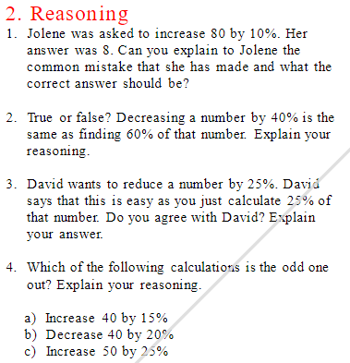
EQ: How do I decrease Percentage
Connections and Reasoning
(1)
True because 40 + 60 = 100 and percentages are out of 100.
(2)
False because 25 + 25 = 50 and percentages are out of 100. David should have calculated 75% as this does add up to 100.

Slide 12
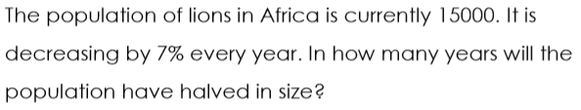
EQ: How do I decrease Percentage
Problem Solving
10 years
A car is valued at $10000 when it is brand new. However, every year the car loses 10% of its value. What is the value of the car after 3 years?
$7290

Slide 13
EQ: How do I decrease Percentage
Plenary
200 increased by 10%
202
210
A)
B)
Correct!
☺
2000
220
C)
D)
Notes:
13

Slide 14

EQ: How do I decrease Percentage
Plenary
80 increased by 10%
Correct!
☺
88
810
A)
B)
90
81
C)
D)
Notes:
14

Slide 15
EQ: How do I decrease Percentage
Plenary
300 increased by 20%
Correct!
☺
320
360
A)
B)
306
312
C)
D)
Notes:
15

Slide 16
EQ: How do I decrease Percentage
Plenary
120 increased by 25%
Correct!
☺
150
160
A)
B)
125
145
C)
D)
Notes:
16

Slide 17
EQ: How do I decrease Percentage
Plenary
500 decreased by 10%
550
490
A)
B)
Correct!
☺
450
400
C)
D)
Notes:
17

